Slide 1
Ola Data Analytics
Dashboard using Power BI

Slide 2
Overview:
The Ola Data Analytics Project in Power BI is an end-to-end data analysis initiative that transforms raw ride-booking data into actionable insights. Analyze ride data to reveal insights like booking trends, cancellation patterns, and ride demand fluctuations. This project would involve using SQL for data extraction and manipulation, and Power BI for visualization and dashboard creation, with the goal of uncovering actionable insights for OLA.

Slide 3
objectives
The objectives of the Ola Data Analytics Project in Power BI typically include:
Data Preprocessing and Cleaning: Ensuring the raw data is accurate and consist by removing duplicates, handling missing values, and standardizing formats.
Detailed Data Analysis: Identifying trends and patterns in ride-booking data, such as booking statuses, revenue trends, and customer satisfaction metrics.
Interactive Dashboards: Creating visualizations to present actionable insights, like ride volume trends, revenue breakdowns, and reasons for cancellations.
Business Insights: Empowering decision-making by highlighting key areas for improvement, such as optimizing operations or enhancing customer experience.

Slide 4
Key aspects of the project:
Data Collection and Preparation:
Gather Ola ride data from various sources (e.g., databases, APIs).
Clean and transform the data to ensure accuracy and consistency.
Potentially use SQL to explore and prepare the data.
Data Modeling:
Create a data model in Power BI that represents the relationships between different data tables.
This model allows for efficient analysis and reporting.
Data Visualization:
Develop dashboards with visualizations to present key insights.
Use various charts and graphs to illustrate data trends and patterns.

Slide 5
Analysis and Insights:
Analyze booking trends, such as popular ride times, locations, and cancellation patterns.
Examine customer behavior, including preferred payment methods and satisfaction levels.
Evaluate revenue generated by different factors like vehicle type, location, and time of day.
Assess driver performance based on metrics like ratings, punctuality, and number of rides completed.
Reporting and Communication:
Generate reports and share dashboards to communicate insights effectively.
Present findings to stakeholders to inform decision-making

Slide 6
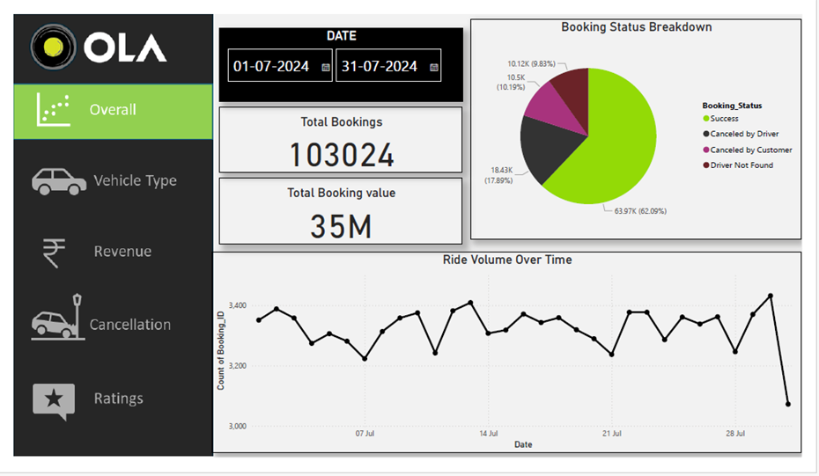

Slide 7
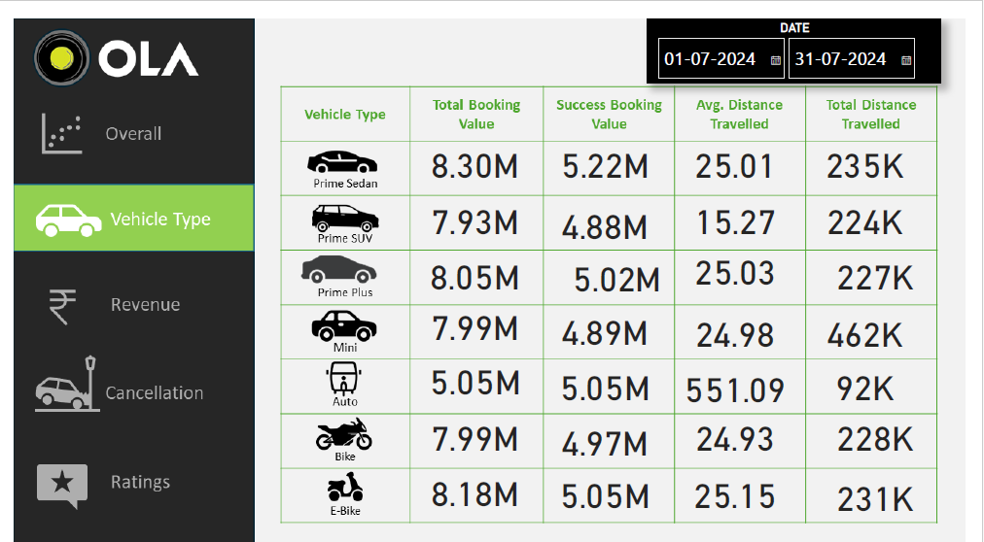

Slide 8
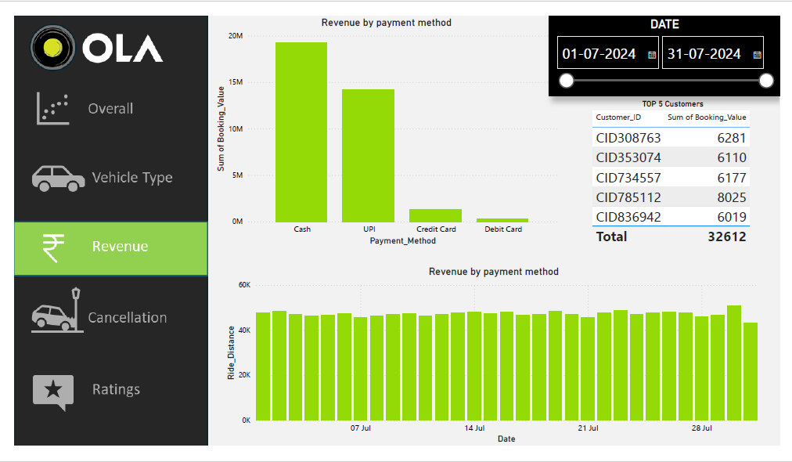

Slide 9
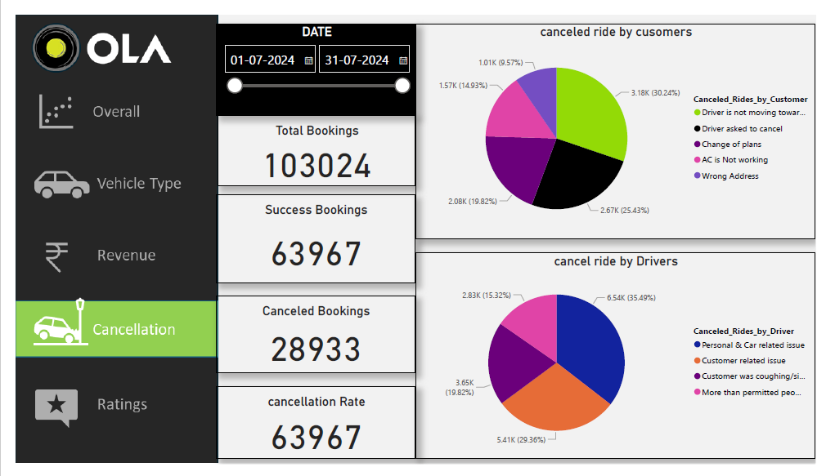

Slide 10
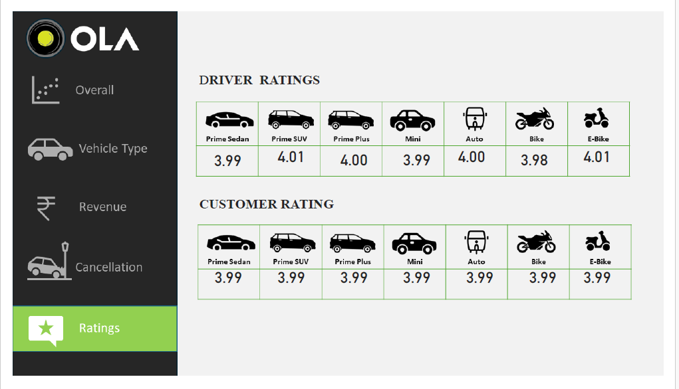

Slide 11
DAX FORMULAS
Canceled bookings = CALCULATE(COUNTROWS(July),July[Booking_Status] IN {"Canceled by driver", "Canceled by Customer"})
Canceled percentage = DIVIDE([Canceled bookings],[TotalBookings],0)
Total Bookings = COUNTROWS(July)

Slide 12
Conclusion
The conclusion of the Ola Data Analytics Project in Power BI typically emphasizes the value of data-driven insights for improving operational efficiency and customer satisfaction. By analyzing ride-booking data, the project identifies trends such as booking patterns, revenue breakdowns, and cancellation reasons. The interactive dashboards created in Power BI provide actionable insights that help Ola optimize its services, enhance user experience, and make informed business decisions.

